Slide 1
Hash Tables
Billy Guenneugues
Evie Klaassen
Anthony Wang
Jeff Yeh

Slide 2
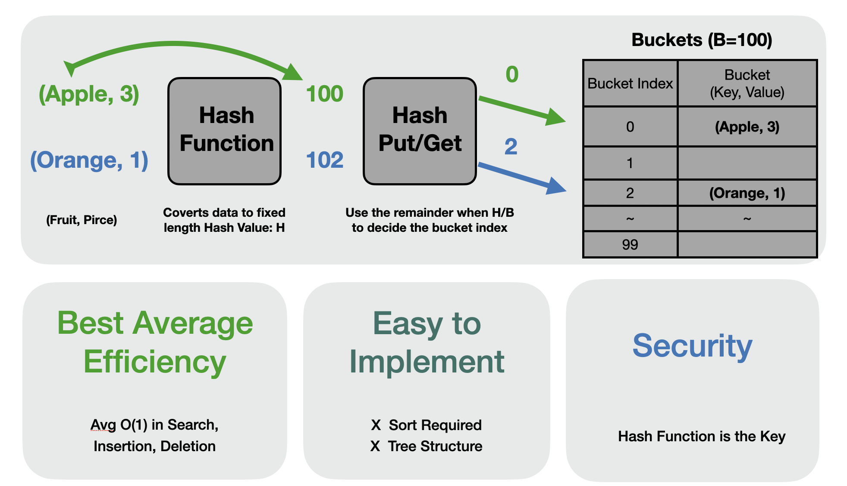
Notes:
Just modified the background color to lighter grey and green. Added the border lines for tables.

Slide 3
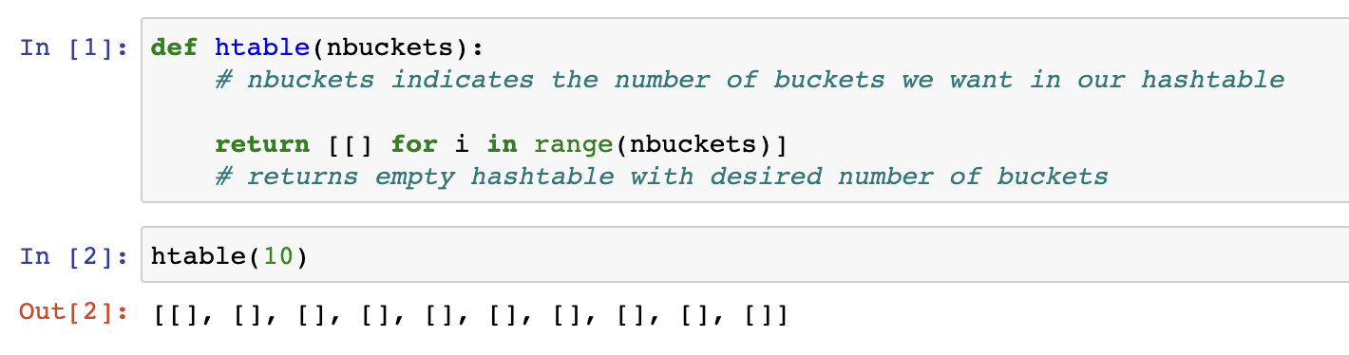
Hash Table Construction
Notes:
Evie

Slide 4
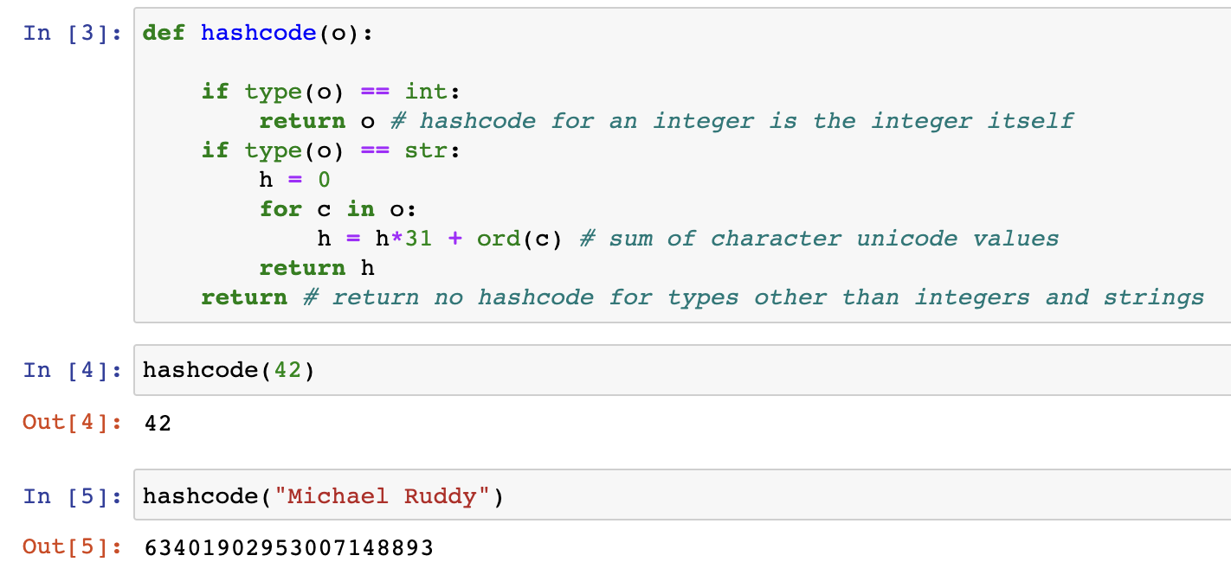
Hash Function
Notes:
Evie

Slide 5
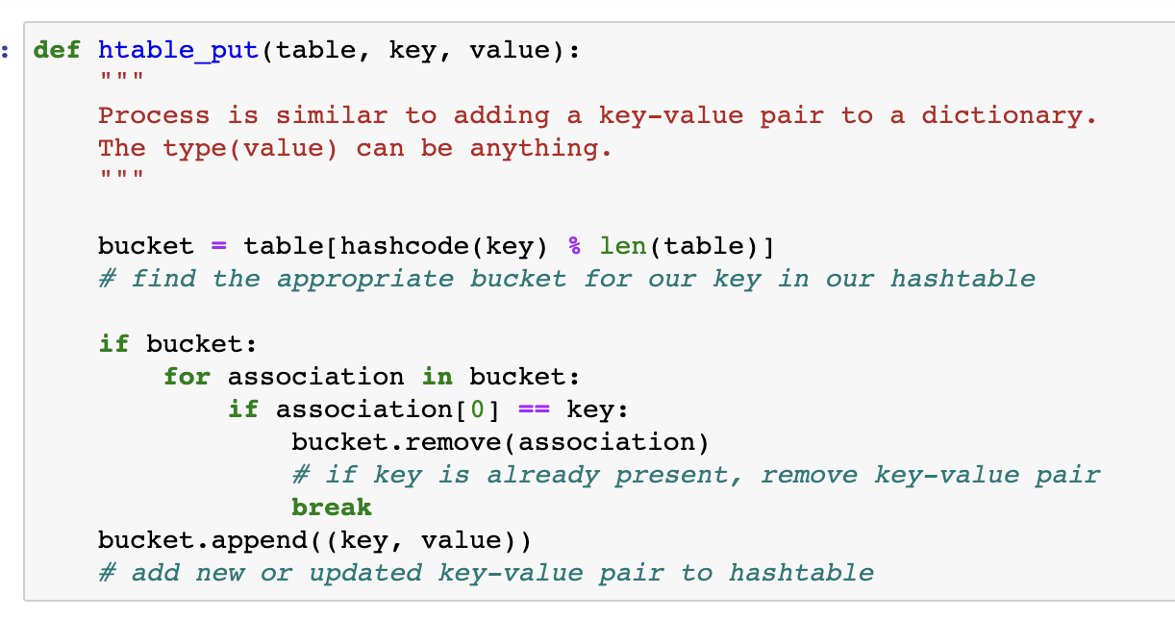
Inserting into a Hash table
Notes:
Evie

Slide 6
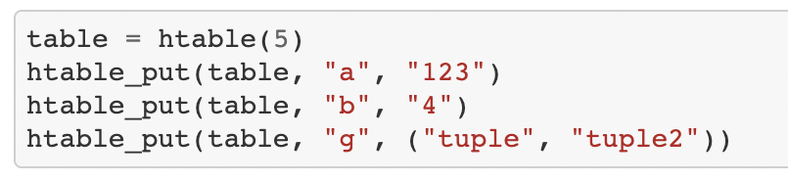
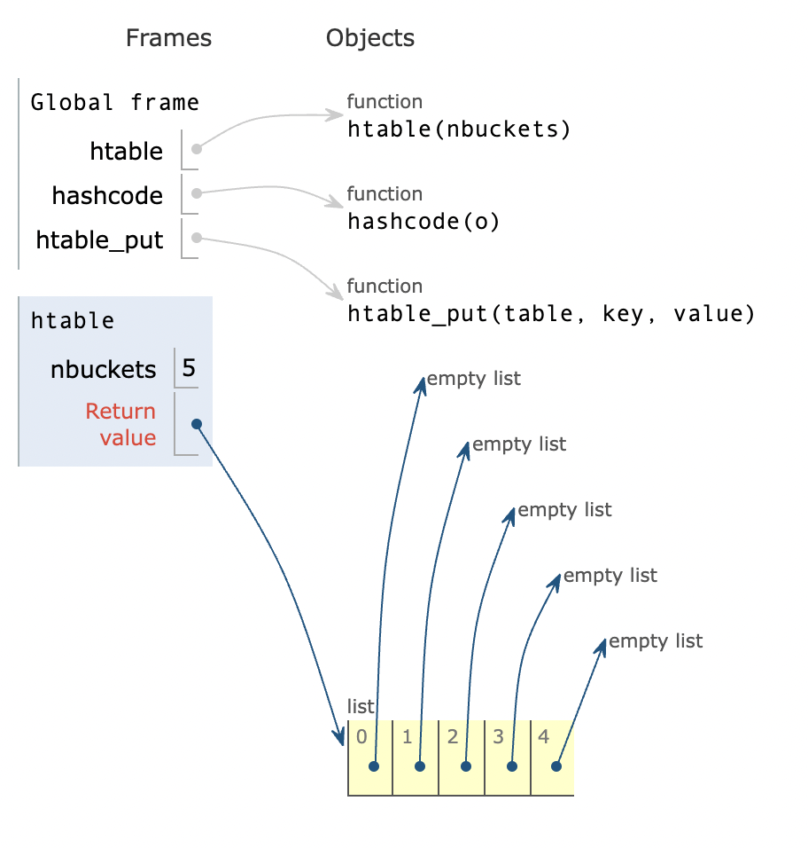
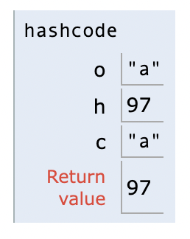
Full Python Tutor Sequence
Notes:
Evie

Slide 7
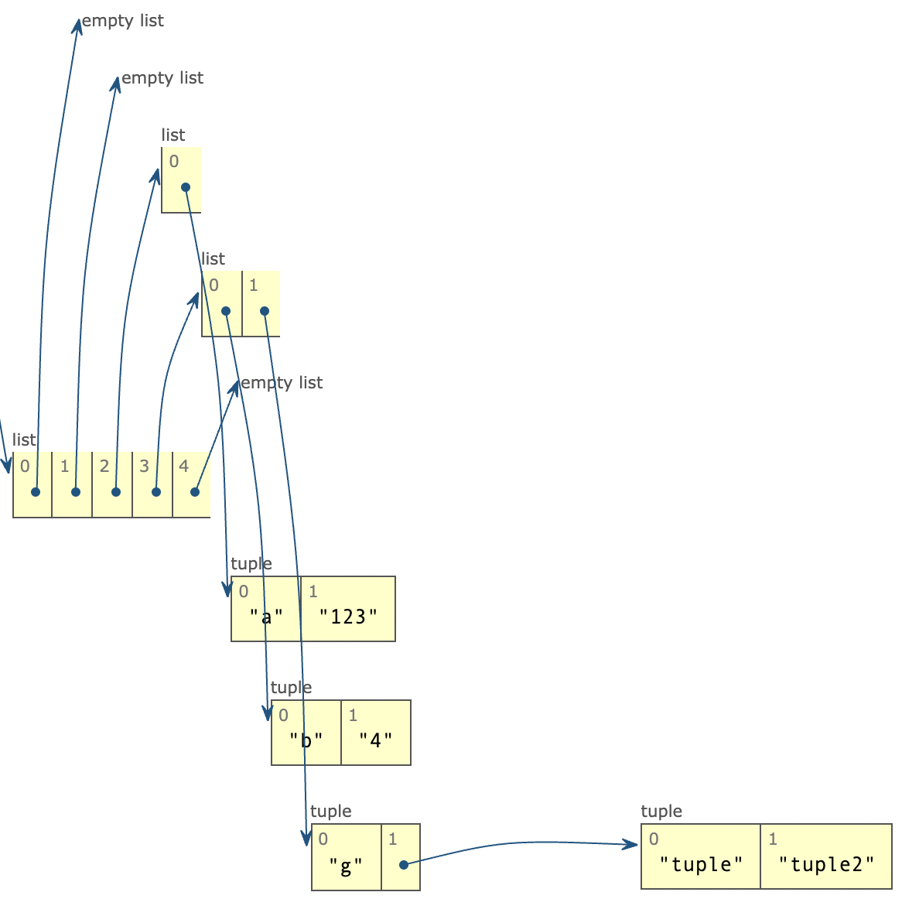
0002 → a : 123
0003 → b : 4, g : (“tuple”, “tuple2”)
Full Python Tutor Sequence
Notes:
Evie

Slide 8
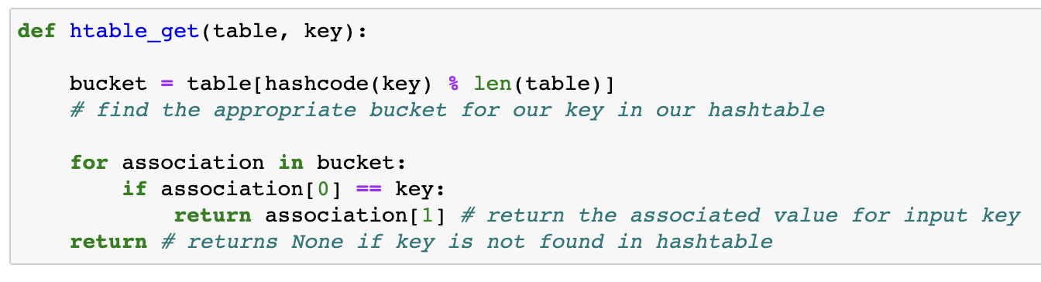
Searching Hash Tables
Notes:
Jeff

Slide 9
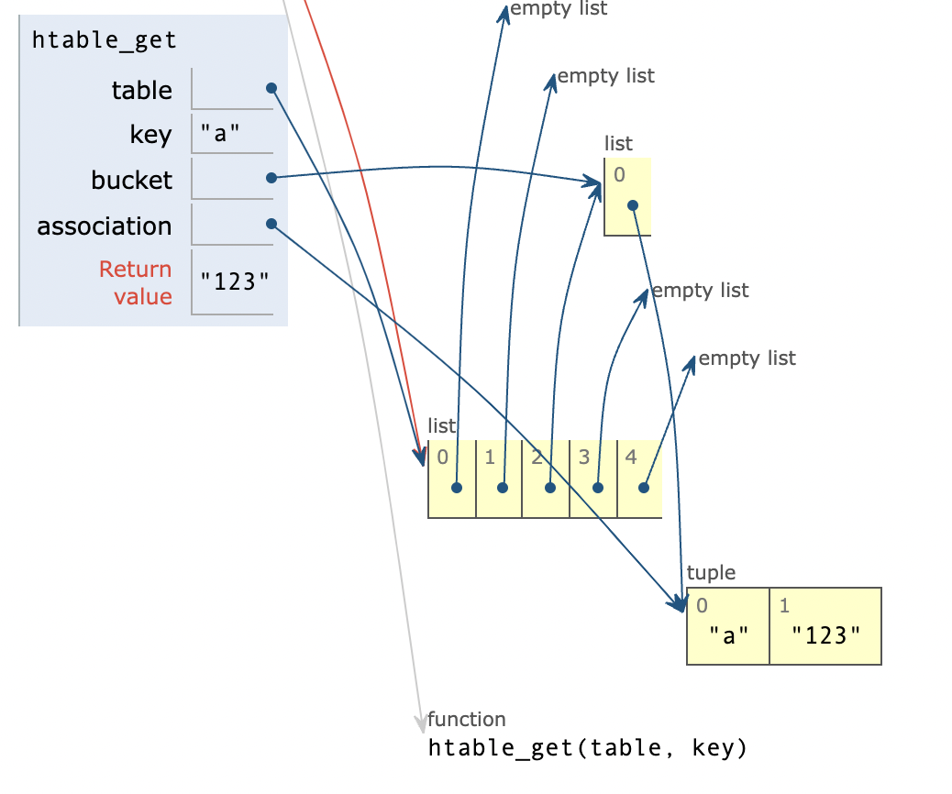
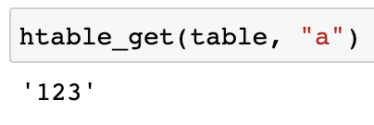
a →0002 → a:123
Full Python Tutor Sequence
Notes:
Jeff

Slide 10
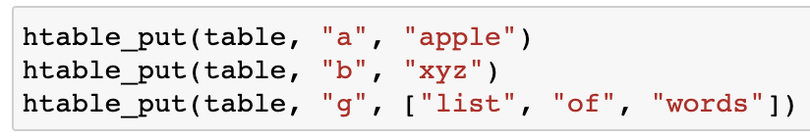
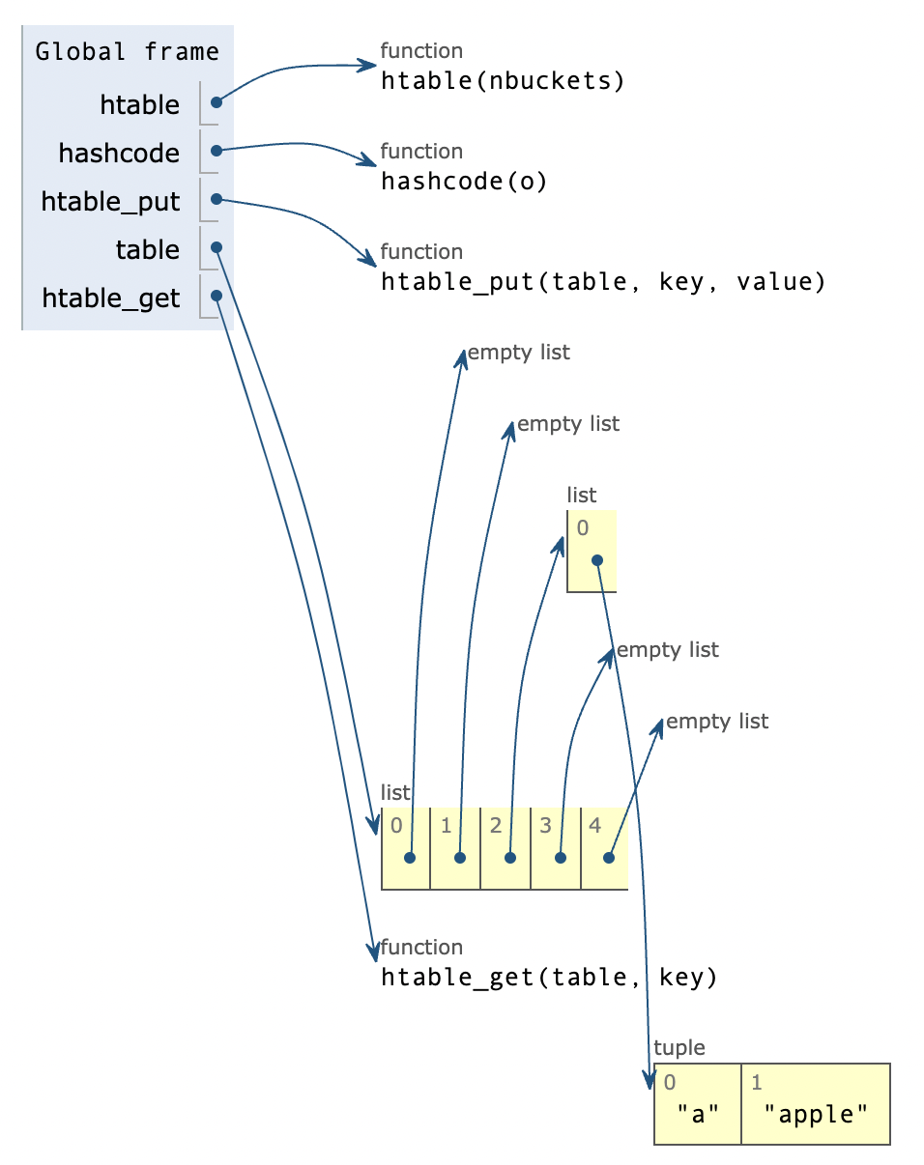
Replacing existing values with put
Bucket Index | Data
2 | a:”123” a:”apple”
3 | b:”4” b:”xyz” g:(‘tuple1’,’tuple2’) g:[“list”,”of”,”words”]
Full Python Tutor Sequence
Notes:
Jeff

Slide 11
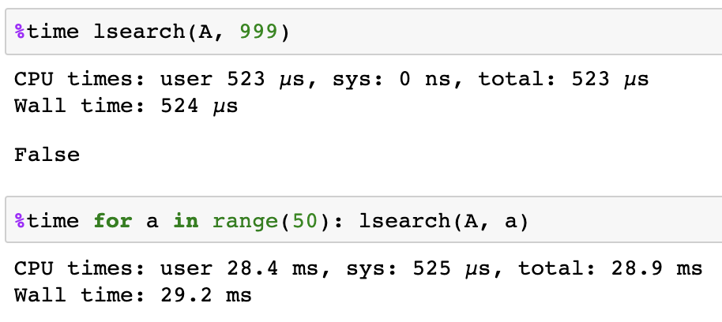
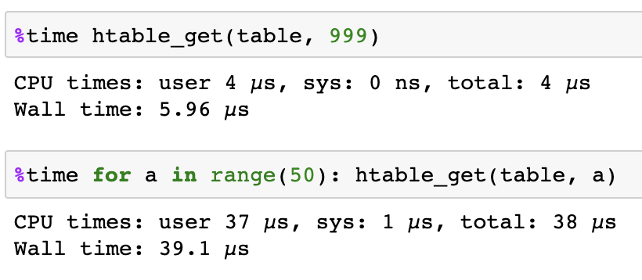
Linear Search vs Hash Table Search
O(N)
O(N/B)
Notes:
Anthony

Slide 12
Potential Issues
Hash code collisions
Uneven distribution of objects
Hash table search becomes more like a linear search, defeating the purpose of the hash table
Fixes
Choose better hash function
Recreate index with more buckets
Notes:
Anthony

Slide 13
Summary
Data structure → list of buckets
Objects evenly distributed into buckets based on key hash code
Adding an object with the same key replaces the old value
Hash searches have time complexity O(N/B)

